Slide 1
Image Captioning Project
Let’s start with the presentation.

Slide 2
What is image captioning ?
Image Captioning is the process of generating a textual description for given images. It has been a very important and fundamental task in the Deep Learning domain.

Slide 3
Examples
Let’s see few examples where a solution to this project can be useful :
Aid to the blind
Self driving cars
Google image search
CCTV Cameras

Slide 4
Data Gathering
There are many open source datasets :
Flicker 8k dataset
Flicker 30k dataset
MS Coco with 180k images
And many more

Slide 5
Dataset
For this project I used Flicker 8k Dataset which contains 8091 images each with 5 captions.

Slide 6
Pre-processing the data :
We need to pre-process the image and caption data before the prediction of our model
For image data we need to convert the image data into fixed size i.e (24 X 24 pixel in my case).
Next step is to pre-process our text data so that our model can understand the vocabulary to describe the images. So for that purpose I did some NLP on top of it before that I removed unwanted data from the text like stopwords , numbers and punctuation marks.
And add the start and end sequence to each caption. For understanding the start and end of the caption.
After preprocessing is done we need to convert the text data into machine understandable language.

Slide 7
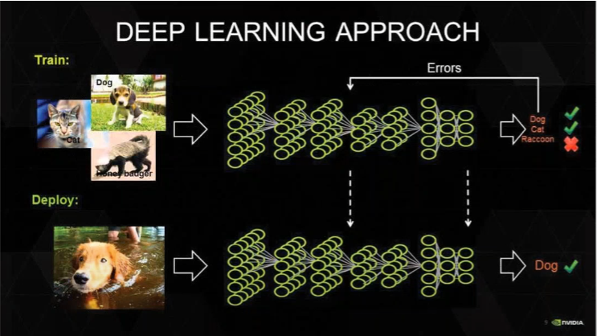
Image model
For image model I used Vgg16 model of 16 layer deep pretrained model
Which is the process of transfer learning.

Slide 8
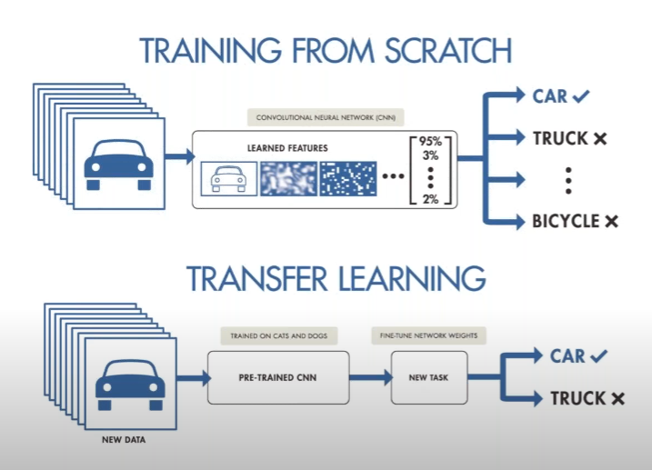
Transfer Learning
Transfer learning is a machine learning technique where a model trained on one task is reused on second related task. Transfer learning is an optimization that allows rapid progress or improved performance when modeling the second task.

Slide 9
Captioning model
Captioning model relies on LSTM . Captioning is all about merging two things /images to combine its most important attribute.
LSTM model is a sequential model which works with any kind of sequential data such as sequence of words.
So by merging of two models you will get a model that can find the patterns and images that can then generate captions related to the images.

Slide 10
Hyperparameters used during training
Epochs : An epoch is a term used in machine learning and indicates the number of passes of the entire training dataset the machine learning algorithm has completed.
Batch : Batch refers to how training samples are used while computing the loss function. It is distinct from online and mini-batch learning.

Slide 11
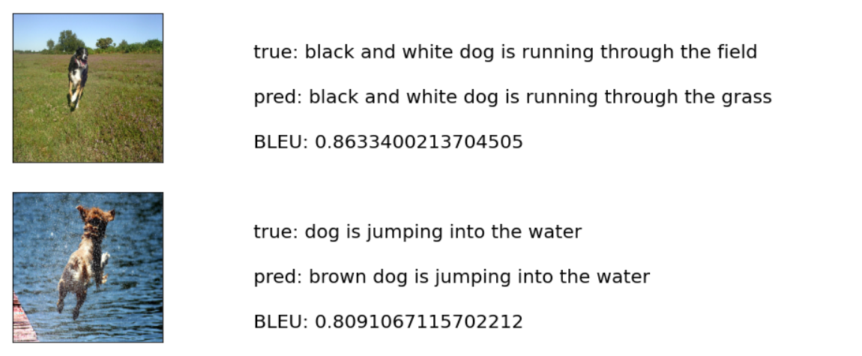
Output :

Slide 12
Thank You!

